Slide 1
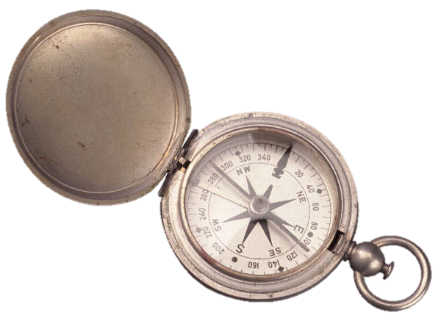
MBTI Step III
What Can the Step III Tell Me that I Don’t Already Know?
BAPT Conference 2015

Slide 2
Order of the Day/Learning Objectives:
Review how the Step III is constructed
Share perspectives on what manifests a personality
Apply these principles to MBTI Step III case studies

Slide 3
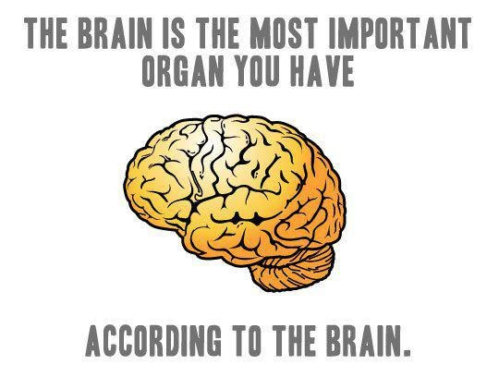
MY BACKGROUND
25 Years in brain injury rehabilitation
6 Years as a personal development coach
MBTI Master Practitioner
Life Long Brain Geek

Slide 4
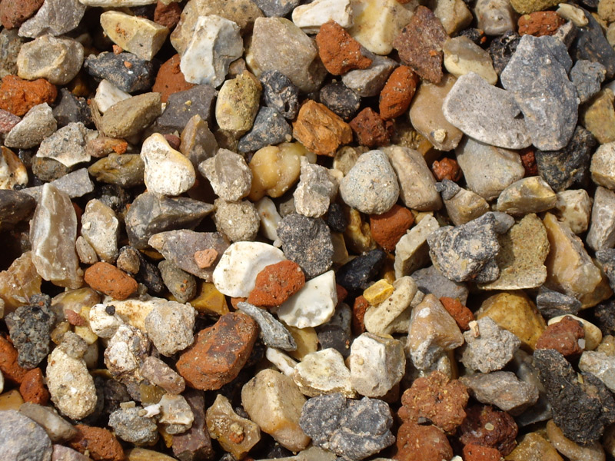
I am an aggregator

Slide 5
I invite you to think like an ENFP today.

Slide 6
Making Connections
Step III + Intriguing Bits From Social and Personality Psychology

Slide 7
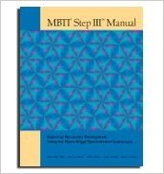
MBTI FORM M + MBTI FORM Q+ COUNSELOR’S REPORT= MBTI STEP III
222 QUESTIONS!

Slide 8
The MBTI Step III is point-in-time
How well you use perception and judgment based on your reported or verified type
Use your strengths and account for blind spots and/or meet developmental challenges
The MBTI Step III assumes you arrived at this particular point in your life for good reasons

Slide 9
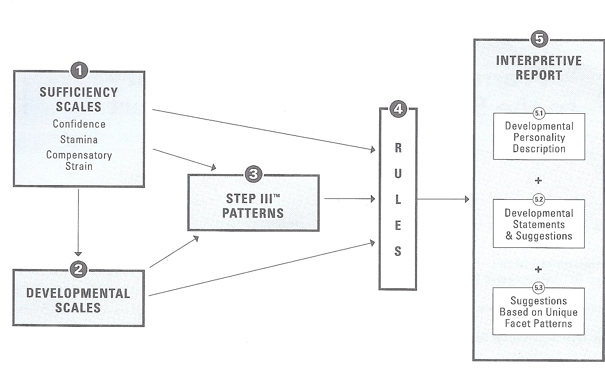
Flow chart for Step III Scales and Patterns and Their Relationship to the Step III Interpretative Report

Slide 10
Type development statements on the Step III report are generated by patterns of responses. One single question does not generate a statement.

Slide 11
The key to the MBTI Step III is the conversation it generates and the awareness it creates
Notes:
ANY QUESTIONS ON THE STEP III BEFORE WE GO ON?

Slide 12
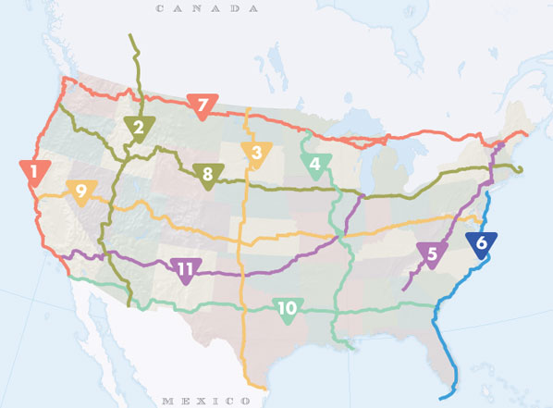
The car is my classroom…

Slide 13
Mark Leary at Duke University, a leading social and personality researcher.

Slide 14
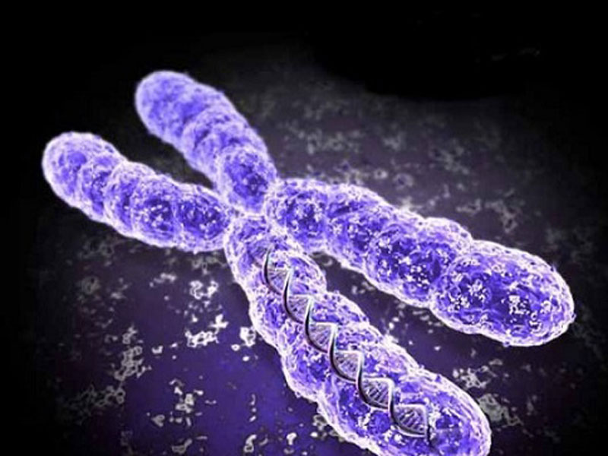
Genes and the heritability of personality.
What percentage of our personality is said to be genetic?

Slide 15
From identical twin studies (Twins reared apart), the overall heritability quotient of personality is between .2-.5.
Extraversion is .5-.6
Activity seeking behavior is .5-.6

Slide 16
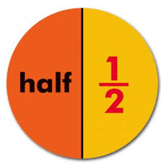
So personality has a high level of genetic influence, approximately half.

Slide 17
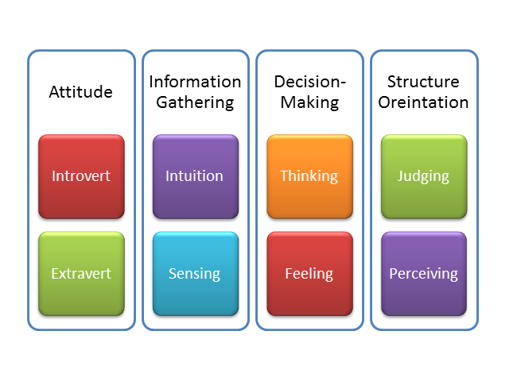
An argument in favor of preferences?
Heritability: We are not inheriting a “trait” by our genetics. We inherit the genes that influence our nervous system to respond in certain ways.
Mark Leary

Slide 18
Inherited genes + environment + environmental choices= PERSONALITY
Inherited genes= 50%
Environment=50%
Passive: Environment that parents set favors shared genetic expression
Evocative: Genetic personality makes others treat someone a certain way.
Active: Genetic make up makes one seek certain environments

Slide 19
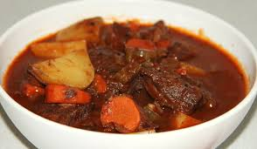
MBTI STEP III PERSONALITY STEW
AN OPPORTUNITY TO EXAMINE TYPE AND EXPERIENCE IN A CONVERSATIONAL FORMAT

Slide 20
SECTIONS IN THE MBTI STEP III
YOUR APPROACH TO THE WORLD
YOUR APPROACH TO RELATIONSHIPS
YOUR APPROACH TO PROBLEM SOLVING
YOUR APPROACH TO DESCISION MAKING

Slide 21
CASE STUDIES
:
ENFP
IN A NUTSHELL: Over-extended and underappreciated.
INFP:
IN A NUTSHELL: On a mission
ENTP:
IN A NUTSHELL: Every man for himself.
Notes:
SHARE HANDOUTS.

Slide 22
The key to the MBTI Step III is the conversation it generates and the awareness it creates
Notes:
ANY QUESTIONS ON THE STEP III BEFORE WE GO ON?

Slide 23
Contact Information:
Email: Annholm@Annholm.net
Websites: Annholm.net
QueenAnntics.net
Annholm.net
AnnholmNet
Linkedin.com/in/annholmnet

